Slide 1
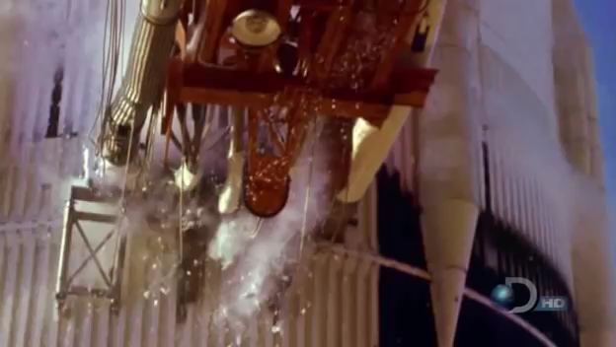

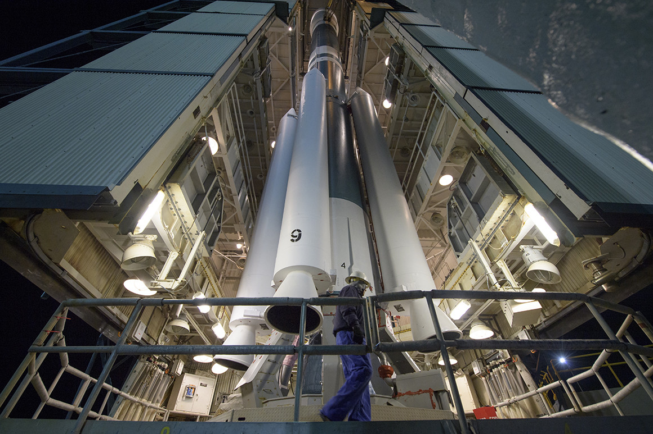
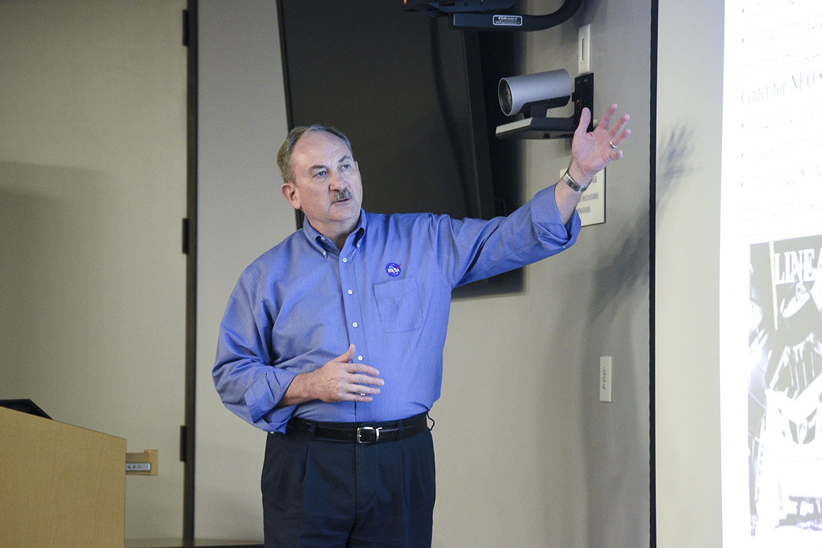






About us
Why join?
Contact us
JOIN NOW!
Latest news
What Trump's proposed Space Force means for Canada
President Donald Trump’s plan to create a U.S. Space Force would require a multiyear reorganization of military operations, with potential spillover effects on existing partnerships that involve Canada.
NASA's asteroid defense program aiming for more impact
The Trump administration has proposed increasing the budget for NASA's Planetary Defense Coordination Office by three-fold -- from some $60 million to $150 million -- amid growing concerns that humanity is utterly unprepared for the unlikely but still unthinkable: an asteroid strike of calamitous proportions..
Sponsored by:

Slide 2
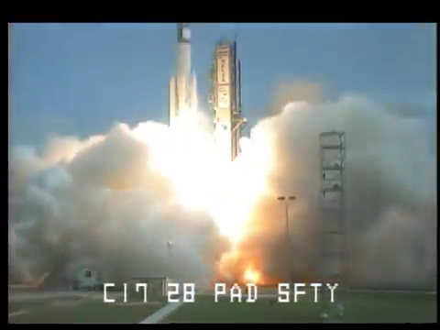
About us
Why join?
Contact us
JOIN NOW!
According to a Department of Defense proposal, the Space Force would absorb Air Force Space Command, the Army's 1st Space Brigade, the Navy's Space and Naval Warfare Systems Command and Naval Satellite Operations Center. The National Reconnaissance Office would not be immediately merged in, although integration would gradually occur. Installations and facilities would remain within their current services until the Space Force achieves an appropriate operating capability. The missions of the Space Force would include space situational advantage; battle management command and control of space forces; space lift and range operations; space support to nuclear command and control; missile warning; satellite communications and position, navigation and timing. Other missions that are tangentially associated with space, such as nuclear intercontinental ballistic missiles, cyber operations and the total missile defense missions, would not immediately be integrated into the Space Force. The proposal also calls for the creation of a Secretary of the Space Force and Chief of Staff of the Space Force, who will be a sitting member of the Joint Chiefs of Staff. The proposal also discussed the creation of a Space Force Reserve and Space National Guard.
Sponsored by:

Slide 3

About us
Why join?
Contact us
JOIN NOW!
You will be able to protect the United States of America in SPACE!
Work with the best Computer Scientist(Mikael Hinton) in the world!
Be able to go to SPACE!
Learn how corrupt the government is!
Become corrupt yourself!
Sponsored by:

Slide 4
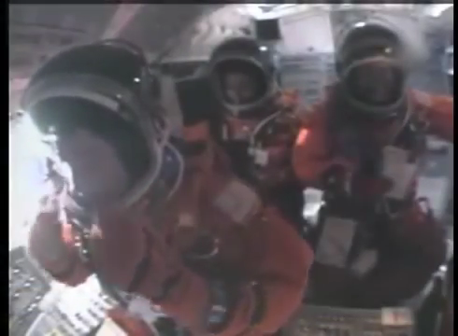
About us
Why join?
Contact us
JOIN NOW!
Phone: (202) 456-1111
Email Address: president@whitehouse.gov
Address: The White House 1600 Pennsylvania Avenue NW Washington, DC 20500
Sponsored by:

Slide 5
About us
Why join?
Contact us
JOIN NOW!
First Name:
Middle Initial:
Last Name:
Email Address:
Phone Number:
Street Address:
City:
State:
ZIP Code:
Bob
T
Thompson
Bthomson@
12346546541
500 Main St.
SUBMIT NOW!
Parkersburg
WV
26101
Sponsored by:

